Slide 1

CS 598 DL4H - Deepr Model Reproducibility Project
By: Mony Chhen and Sanjib Kumar Panigrahi

Slide 2
Motivation for Deepr
Modern Medicine does not have the capability of estimating future medical risks for individual patient.
Risks include:
Readmission after discharge
The onset of specific diseases
Worsening from a condition
With such capability would facilitate prevention or intervention for maximum health impact and provide major step toward personalized healthcare to patient.

Slide 3
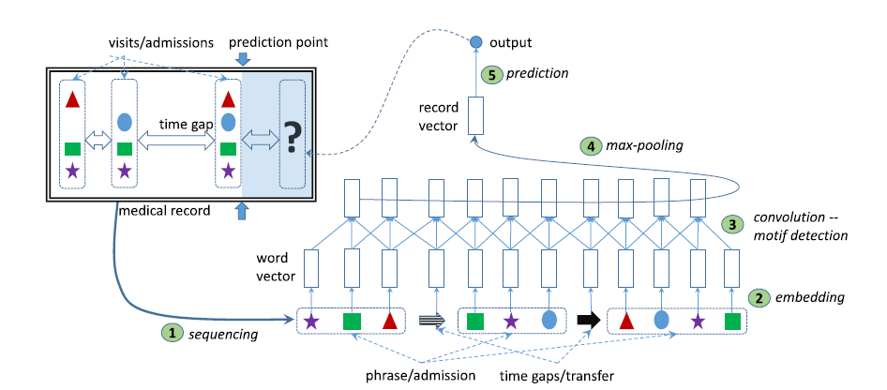
Deepr Model Overview
New Prediction Framework based on Deep Learning
New revolutionary approach aims to build multilayered neural learning system
A multilayered architecture base on CNNs.

Slide 4
Author’s Deepr Implementation
Deepr is the use of a multi-view CNN architecture, which enables the model to incorporate multiple sources of information from the EMR data.
Multi-Layers Includes:
Sequencing EMR
Embedding
Convolution
Classifier

Slide 5
Our Deepr Implementation
We compared the performance of Bag-of-Words (BoW) and logistic regression (LR) with Deepr, a convolutional neural network (CNN) model, for predicting patient readmission using electronic medical records (EMRs) of UCI dataset.
Bag-of-Words + Logistic Regression
BoW+LR is a simple but effective method for text classification, where the text is represented as a bag of individual words and a logistic regression model is trained on the word frequencies. In the context of EMRs, each medical event (e.g., diagnosis, medication, procedure) can be represented as a word, and the entire sequence of medical events for a patient can be represented as a bag of words.
Deepr (with Random Initialization)
Deepr is a deep learning model based on CNNs that operates directly on sequences of medical events in the EMRs. Deepr is designed to capture complex patterns and relationships in the sequential data by using convolutional filters to detect relevant features at different levels of abstraction.
The authors experiment with a version of the Deepr model with random initialization of the word embeddings.
Deepr (with Word2Vec Initialization)
We also experiment with a version of the Deepr model that uses pre-trained word embeddings using Word2Vec. Word2Vec is a popular algorithm for learning word embeddings, which are dense vector representations of words that capture their semantic meaning based on their context.

Slide 6
Results Comparison
Difference shown below are due to the dataset difference between Authors and our implementations:
Authors used MIMIC-III Dataset
We used Diabetes Dataset
Methods | Author’s Implementation | Our Implementation
BoW | 0.786 | 0.552
Deepr (rand init) | 0.791 | 0.574
Deepr (word2vec) | 0.795 | 0.755

